Slide 1
Manuscript writing: Literature Reviews
Dr Jeff Buckley, PhD.
Jeffrey.buckley@tus.ie

Slide 2

Why conduct a literature review?

Slide 3
What is a literature review
“Gathering research, getting rid of rubbish and summarizing the best of what remains captures the essence of the science of systematic review.”
(Grant and Booth, 2009)

Slide 4
Types of literature review

Slide 5
Type of literature review
Critical review
Narrative Literature review
Mapping review
Meta-analysis
Mixed methods review
Overview
Qualitative systematic review
Rapid review
Scoping review
State-of-the-art review
Systematic review
Systematic search and review
Systematised review
Umbrella review
Examples will be shown of a select few
(Grant and Booth, 2009)

Slide 6
Structuring a literature review

Slide 7
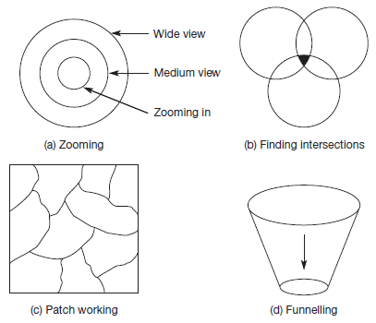
Picturing your literature review
(Wellington et al., 2005)

Slide 8
Zooming in
Most broad (Follows introduction)
Intermediate section
Intermediate section
Most specific (Immediately before method)
(Wellington et al., 2005)

Slide 9
Zooming in
Most broad (Follows introduction)
Intermediate section
Intermediate section
Most specific (Immediately before method)
1. Introduction
1.1. Introduction sub-sections
1.2. …
1.3. …
2. Literature review
2.1. Broadest thematic area
2.1.1 Sub-section 1
2.1.2 Sub-section 2
2.2. Next broadest thematic area
2.2.1 Sub-section 1
Etc.
(Wellington et al., 2005)

Slide 10
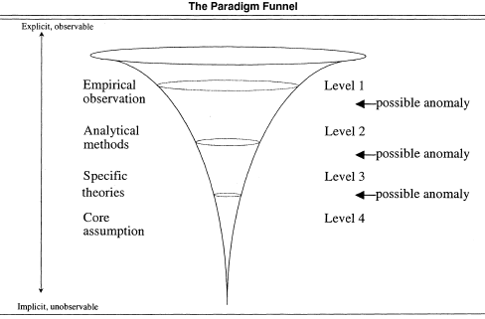
Funnelling
(Berthon et al., 2003)

Slide 11
Funnelling
1. Introduction
1.1. Introduction sub-sections
1.2. …
1.3. …
2. Literature review
2.1. Empirical observations
2.1.1 Sub-section 1
2.1.2 Sub-section 2
2.2. Analytical methods
2.2.1 Sub-section 1
Etc.
(Berthon et al., 2003)

Slide 12
Finding intersections
1. Introduction
1.1. Introduction sub-sections
1.2. …
1.3. …
2. Literature review
2.1. Thematic area 1
2.1.1 Broadest area
2.1.2 Intermediate section
2.1.3 Narrowest area
2.2. Thematic area 2
2.2.1 Broadest area
2.2.2 Intermediate section
2.2.3 Narrowest area
2.3. Synthesis (possibly just one section)
2.3.1 Broadest area of synthesis
2.3.2 Intermediate area of synthesis
2.3.3 Narrowest area of synthesis
Funnelling
Finding intersections
(Wellington et al., 2005)

Slide 13
Finding intersections
1. Introduction
1.1. Introduction sub-sections
1.2. …
1.3. …
2. Literature review
2.1. Thematic area 1
2.1.1 Broadest area
2.1.2 Intermediate section
2.1.3 Narrowest area
2.1.4 Link to next area
2.2. Thematic area 2
2.2.1 Link to previous area
2.2.1 Broadest area
2.2.2 Intermediate section
2.2.3 Narrowest area
Funnelling
Choose one
(Wellington et al., 2005)
No overall synthesis as it occurred throughout

Slide 14
What approach do you think fits your work best?

Slide 15
Literature searching and management

Slide 16
Literature searching and management
Identify literature
Google Scholar with alerts
Databases
Manage literature
Mendeley
Endnote
Report literature
Prisma guidelines
Websites (e.g., connected papers)
Zotero

Slide 17
Starting with a question
Start with your research question:
RQ: How is post-graduate research education experienced by doctoral students?
Note: This is very broad, but it is for demonstration purposes only

Slide 18
Breaking down the question
Identifying synonyms, analogies, exemplars, etc.:
RQ: How is post-graduate research education experienced by doctoral students?

Slide 19
Breaking down the question
Identifying synonyms, analogies, exemplars, etc.:
RQ: How is post-graduate research education experienced by doctoral students?
PG Research Education
Experienced
Doctoral students
Doctoral education
Masters education
Post-graduate education
Research education
Graduate education
Graduate studies
Challenging
Difficult
Exciting
Lonely
Fulfilment
Emotion
Feelings
Find
Doctoral
Masters
Research
Students
Candidates
Fellows
Researchers

Slide 20
Boolean search commands
Boolean commands: “AND”, “OR”, and “NOT”
All the literature
Term 1
Term 2

Slide 21
Truncation of search terms
In most databases, the * symbol is used for truncation (please check specific databases before assuming this though):
If you searched for the term “education” and specified that it must be in the document title, only documents with “education” spelled exactly that way would be returned.
If, however, you searched for the term “educat*” and specified that it must be in the document title. Your search would return documents which had any word starting with the text string “educat” in the title.
For example, a search for “education” would not return a document with the title
“Best practices in educating doctoral students in scientific fields”
But a search for “educat*” would.

Slide 22
Creating a search protocol
“Post-graduate research education” AND | “Experienced” AND | “Doctoral” AND | “Students”
“post-graduate research educat*” OR | “experience*” OR | “doctor*” OR | “student*” OR
“post-graduate educat*” OR | “challeng*” OR | “research*” OR | “candidat*” OR
“doctoral educat*” OR | “reward*” | “PhD” OR | “scholar*”
“masters educat*” |  | “master*”

Slide 23
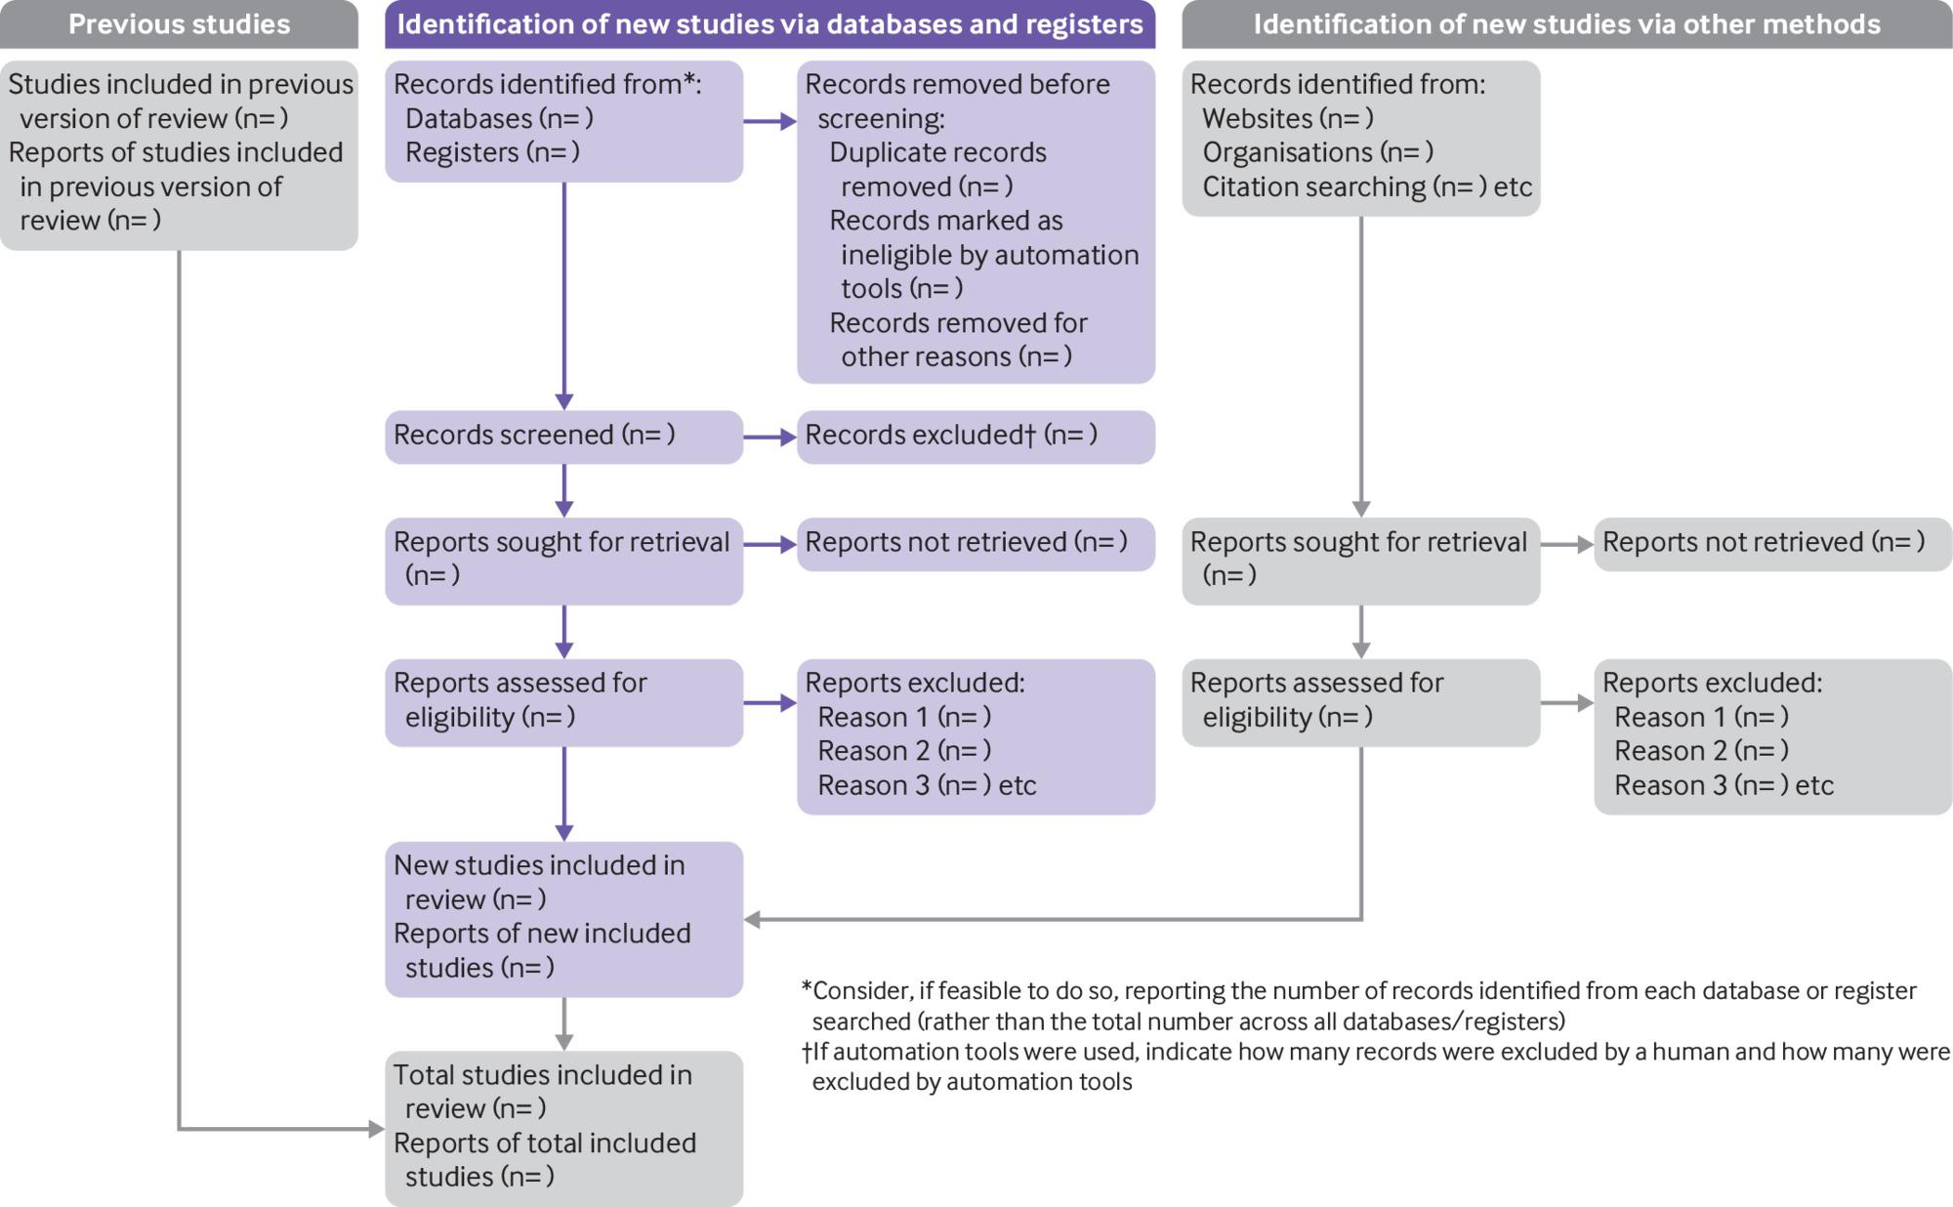
PRISMA 2020

Slide 24
Live demonstration
A live demonstration will now take place on:
Searching the Scopus database
Downloading a search result and importing into Zotero
Using Zotero for reference management and MS Word incorporation
Retrieving PDF files for review

